Slide 1

Latent Variable Models of A Learning Brain
By Arnold Cheskis
Kabir Dabholkar
Omri Barak

Slide 2
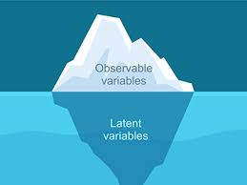
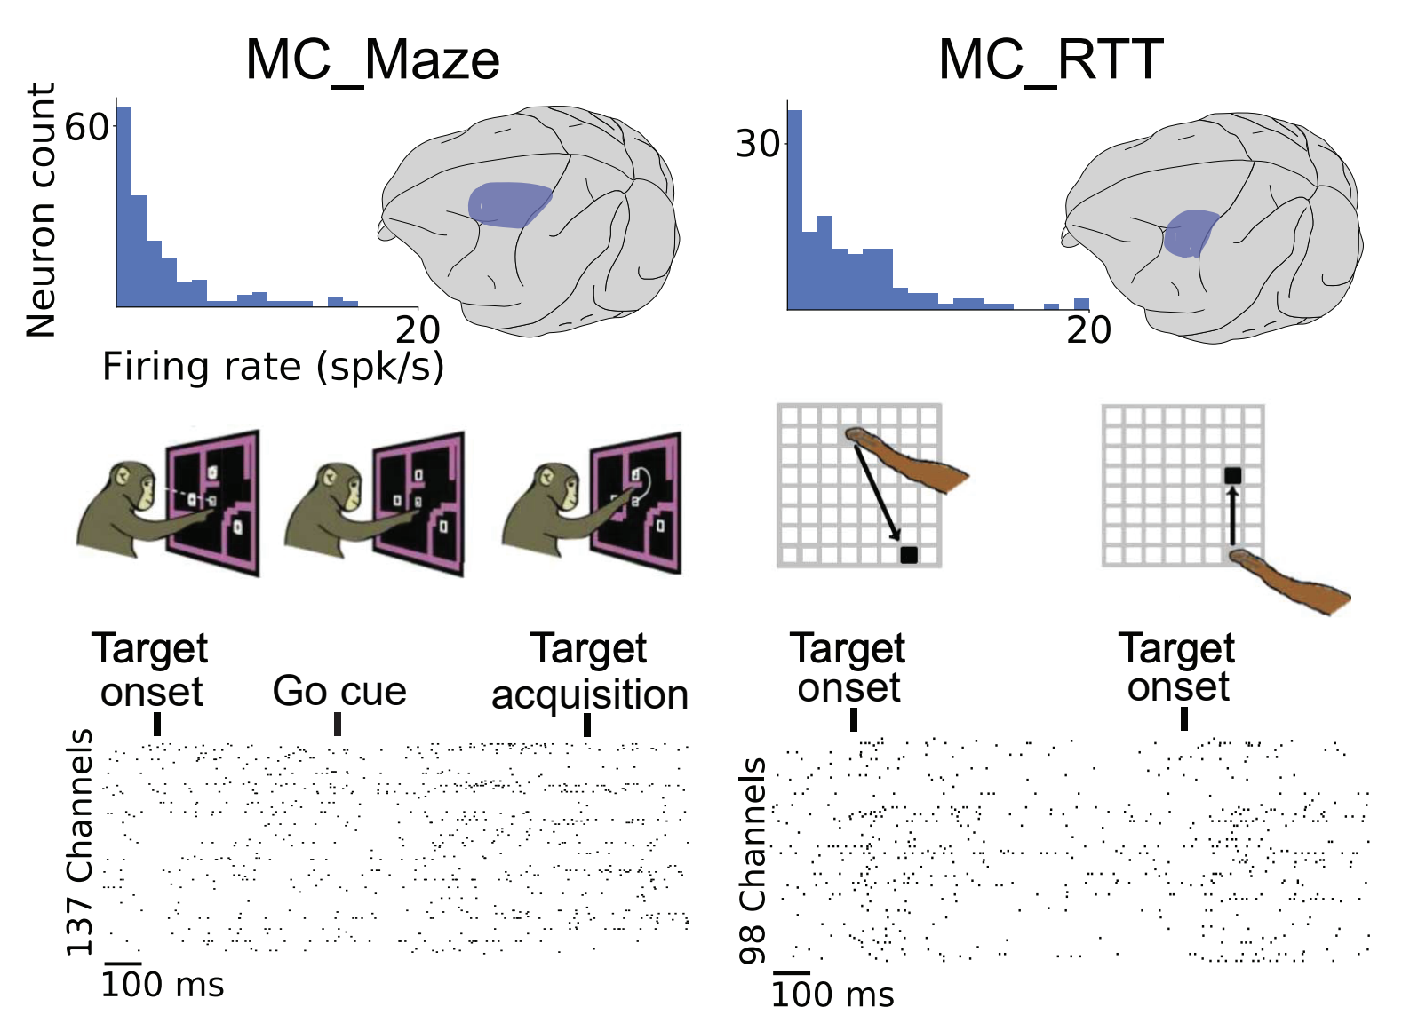
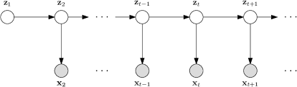
Background
LVM
Brain changes over time
arXiv:2109.04463
Notes:
1. Latent variable models (LVMs) are used to capture the dynamics of neural circuits given recordings of signals from the brain – hidden/latent states represent the brain’s inner workings 2. LVMs assume that the dynamical system remains fixed – given a stimulation the transitions will happen in the same way, not accounting for synaptic changes (brain evolving over time,’learning’)
3. We study the novel scenario of fitting LVMs to a learning brain using a student-teacher setting (in a few slides) – we want the LVM to function like the monkey’s brain

Slide 3
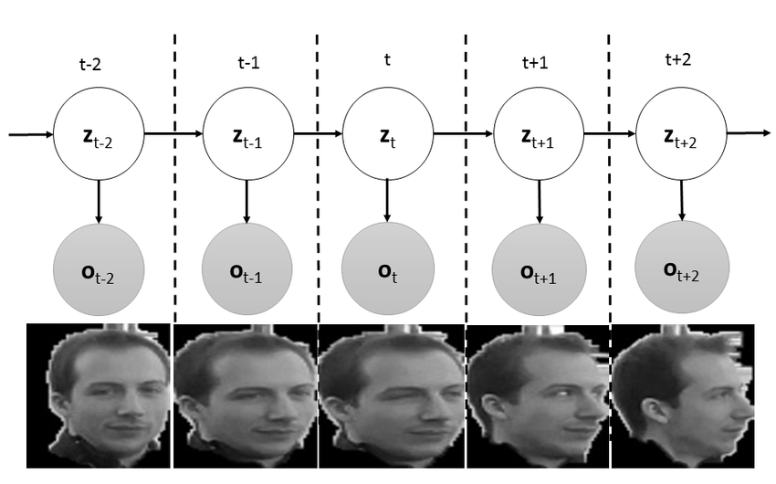
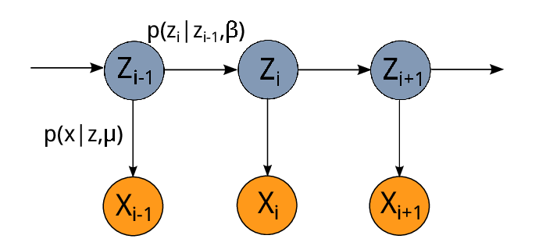
Student – Teacher settings
Teacher
aka ”ground truth”
Student
Notes:
A couple of words. Will elaborate more on this in the next slides.

Slide 4
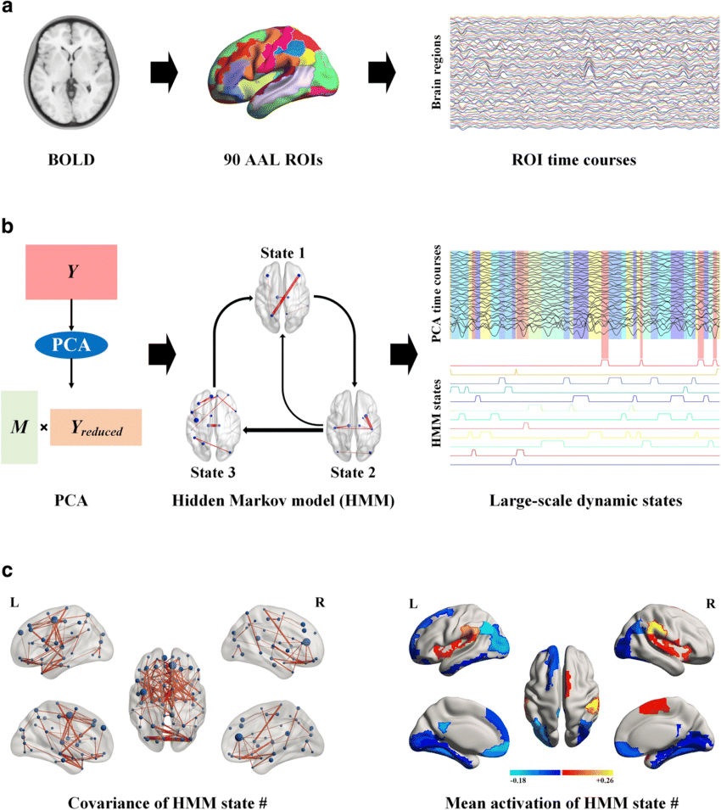



Goal (as of today)
$$t_{0}$$
$$t_{1}$$
$$t_{2}$$
Deduce whether observing the learning process could help discriminate “bad” models⁽¹⁾ → better models
(1) arXiv:2405.14425
Notes:
Explain what ”bad” means

Slide 5
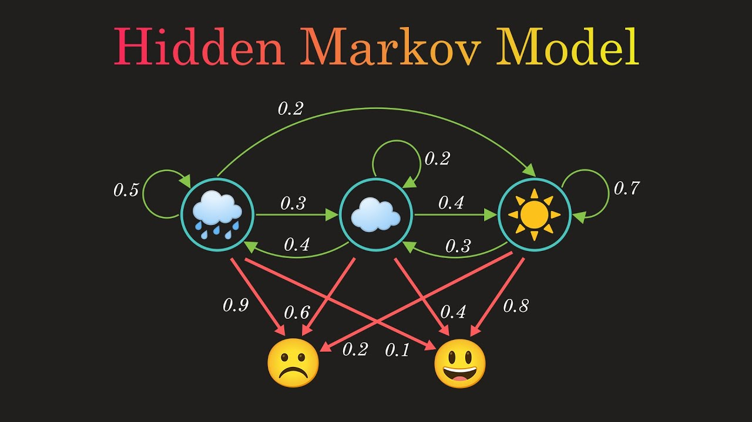


Hidden Markovian Models (HMMs)
HMM is an LVM structure that is uniquely defined by the tuple $(A, π, \left\{μ,Σ\right\})$
Training HMM
Trial = $\left(v_{1:T}\right)$, HMM gives $p\left(v_{1:T}\right)$
$h_{1}\sim π , P\left(h_{1}\right)=π$.
$A= p\left(h_{2} | h_{1}\right)$
$Repeat for h_{3},h_{4},…h_{T}$
$\left\{μ,Σ\right\}$ -> get $p(v_{0:T})$ from $p\left(v_{t} | h_{t}\right) , ∀t∈\left[T\right]∪\{0\}$
Optimization algo, e.g. gradient descent (GD)
Optimal parameters ($A_{student}$, $π_{student}$, ${\{μ,Σ\}}_{student}$) which maximize $p\left(v_{1:T}=\left({v^{′}}_{1},{v^{′}}_{2},…{v^{′}}_{n}\right)\right)$
($A_{student}$, $π_{student}$, ${\{μ,Σ\}}_{student}$)
Notes:
Explain the tuple.
Sample the initial hidden states using the initial distributions π. We can get, for instance, $h_{1}=3$.
Sample the following hidden states using the transition matrix. E.g., if $h_{1}=3 then$ we sample $h_{1} \text{from} p(h_{2}|h_{1}=3)$
Similarly, we repeat the process for $h_{3},h_{4},…h_{T}$
Finally, using the emission matrix, $\left\{μ,Σ\right\}$, we sample the observations $p(v_{0:T})$ from $p\left(v_{t} | h_{t}\right) , ∀t∈\left[T\right]∪\{0\}$

Slide 6

How?
The learning brain (our “ground truth”) - $T_{0}, T_{1},T_{2}…T_{k}\text{ (}T_{i}\text{ = }T_{i−1}\text{ + }ε\text{)}$
Our training approach = curriculum
Students - $S_{1},S_{11},S_{12},S_{2},S_{22}$ trained on $T_{1},T_{1}→T_{1},T_{1}→T_{2}$ …
Evaluate on unseen $T_{k+1}$
Notes:
To represent the learning process, we init a teacher
How we init the teacher (size of dim, states, params type- diagonal…)
Explain the perturbation $T_{i}\text{ = }T_{i−1}\text{ + }ε$
To capture the learning process we use curriculum. Different options S1, S11, S01 … Explain notation
We evaluate the “next” teacher (i.e. the next timestamp in the learning process of the brain)

Slide 7
Expectations
Notes:
After familiarizing myself with the framework, I began comparing different settings and training methods for the students.
What I was hoping to see S11 is not optimal. Even though there are no grounds to believe that – Discuss in the next meeting. I believe, that if the second perturbation cancels the first, it will be lucrative to utilize the history. Otherwise, only train on the latest model (T1 in this case). So maybe, if we have a lot of perturbations, they might bring us back at some point?

Slide 8
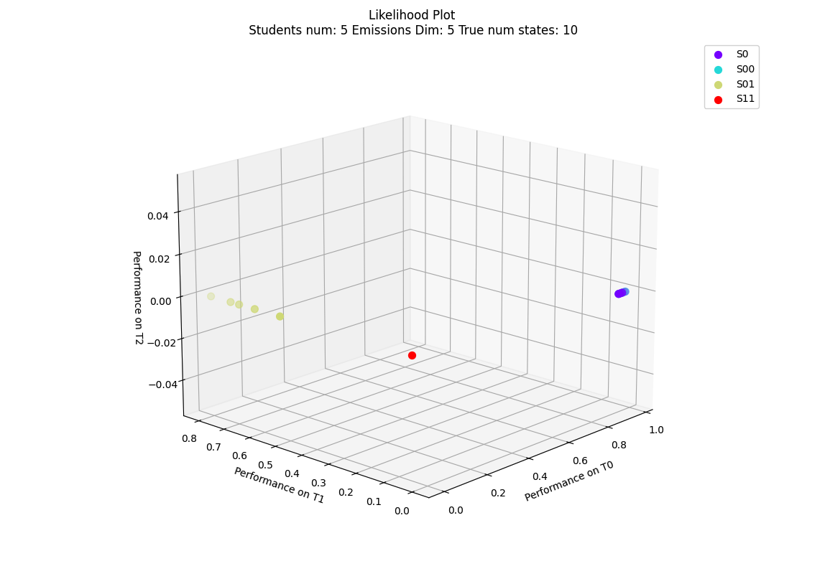
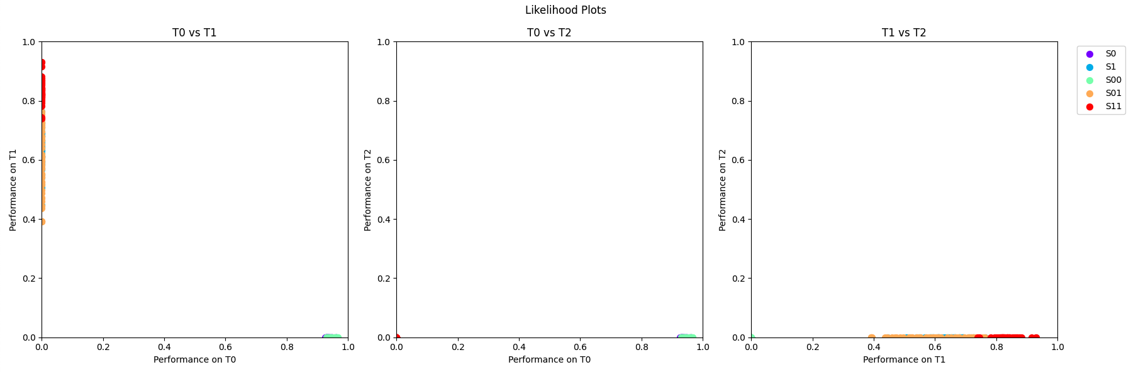
Current results
Notes:
Here I did expect improvement based on Kabir’s paper

Slide 9

Next steps
Generalize hyper-parameters:
Perturbation types ($T_{1},T_{2}…T_{k}$ from GD)
Teachers’ size
Emissions’ dimensions
Infer trajectory
More complex curricula $S_{1},S_{11},S_{12},S_{2},S_{22}…S_{12…k}$
In addition to our normalized likelihood use cross-decoding to visualize data.
Notes:
Then, perhaps, we’ll choose the likelihood over $T_{k}$ as one of the axes. For the other/s there are several options. One could be the highest likelihood each model had over any of the models (the detect if ”overfitting” helped), and a third one could simply be a discrete grid [1…k] representing the teacher’s num over which the likelihood of each model was the best.
Perturbations - (right now some of the perturbations are diagonal matrices)

Slide 10
Sources
Dabholkar, K., & Barak, O. (2024). When predict can also explain: Few-shot prediction to select better neural latents (arXiv:2405.14425). arXiv. http://arxiv.org/abs/2405.14425
Duncker, L., & Sahani, M. (2021). Dynamics on the manifold: Identifying computational dynamical activity from neural population recordings. Current Opinion in Neurobiology, 70, 163–170. https://doi.org/10.1016/j.conb.2021.10.014
Mathematical models of learning and what can be learned from them—PubMed. (n.d.). Retrieved August 4, 2024, from https://pubmed.ncbi.nlm.nih.gov/37043892/
Pei, F., Ye, J., Zoltowski, D., Wu, A., Chowdhury, R. H., Sohn, H., O’Doherty, J. E., Shenoy, K. V., Kaufman, M. T., Churchland, M., Jazayeri, M., Miller, L. E., Pillow, J., Park, I. M., Dyer, E. L., & Pandarinath, C. (2022). Neural Latents Benchmark ’21: Evaluating latent variable models of neural population activity (arXiv:2109.04463). arXiv. https://doi.org/10.48550/arXiv.2109.04463
https://neurallatents.github.io/
Stanford document about HMM Maybe:
Barak O. Recurrent neural networks as versatile tools of neuroscience research. Curr Opin Neurobiol. 2017 Oct;46:1-6. doi: 10.1016/j.conb.2017.06.003. Epub 2017 Jun 29. PMID: 28668365.

